Slide 1
Neural Architectures
Introduction to Deep Learning: Class 5.1

Slide 2
Neural Network Architectures
Neural Architectures: How do we organize neurons into layers and connect the layers into networks to take advantage of the natural structure in the training data
Images / grids → CNN / ResNet / U-Net
Text / sequence transduction → Transformer encoder–decoder
Relations / molecules / networks → GNN
Variational Auto-Encoders: Learning features using self-supervision
Generative models

Slide 3
Pre-read
Standford Uni lecture notes

Slide 4
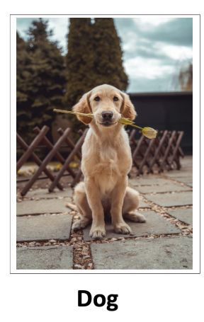
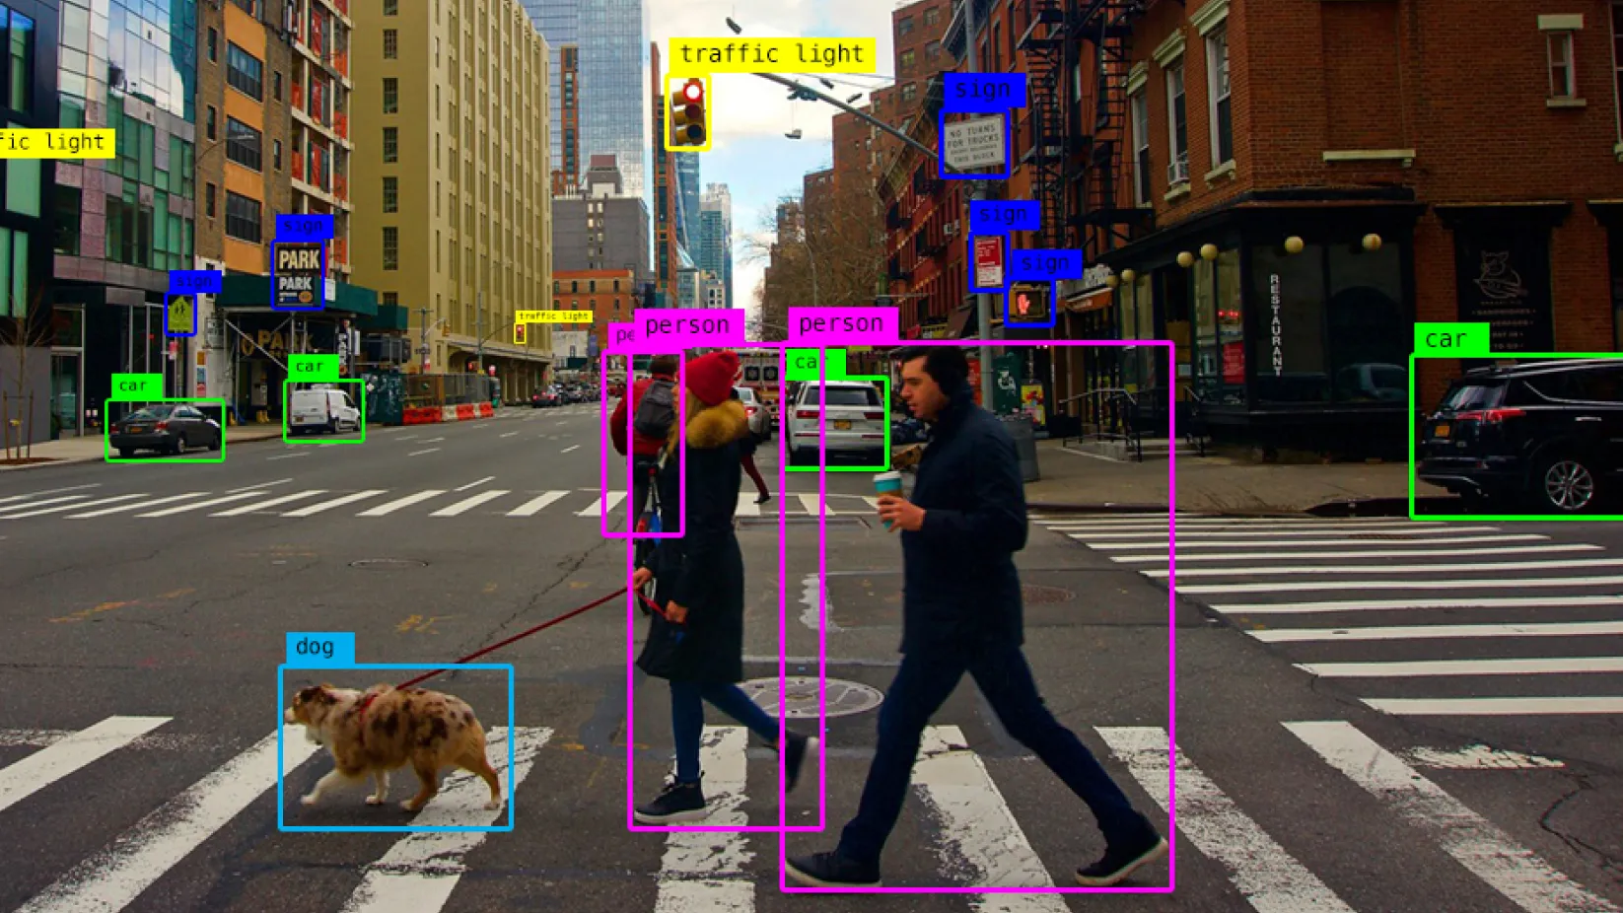
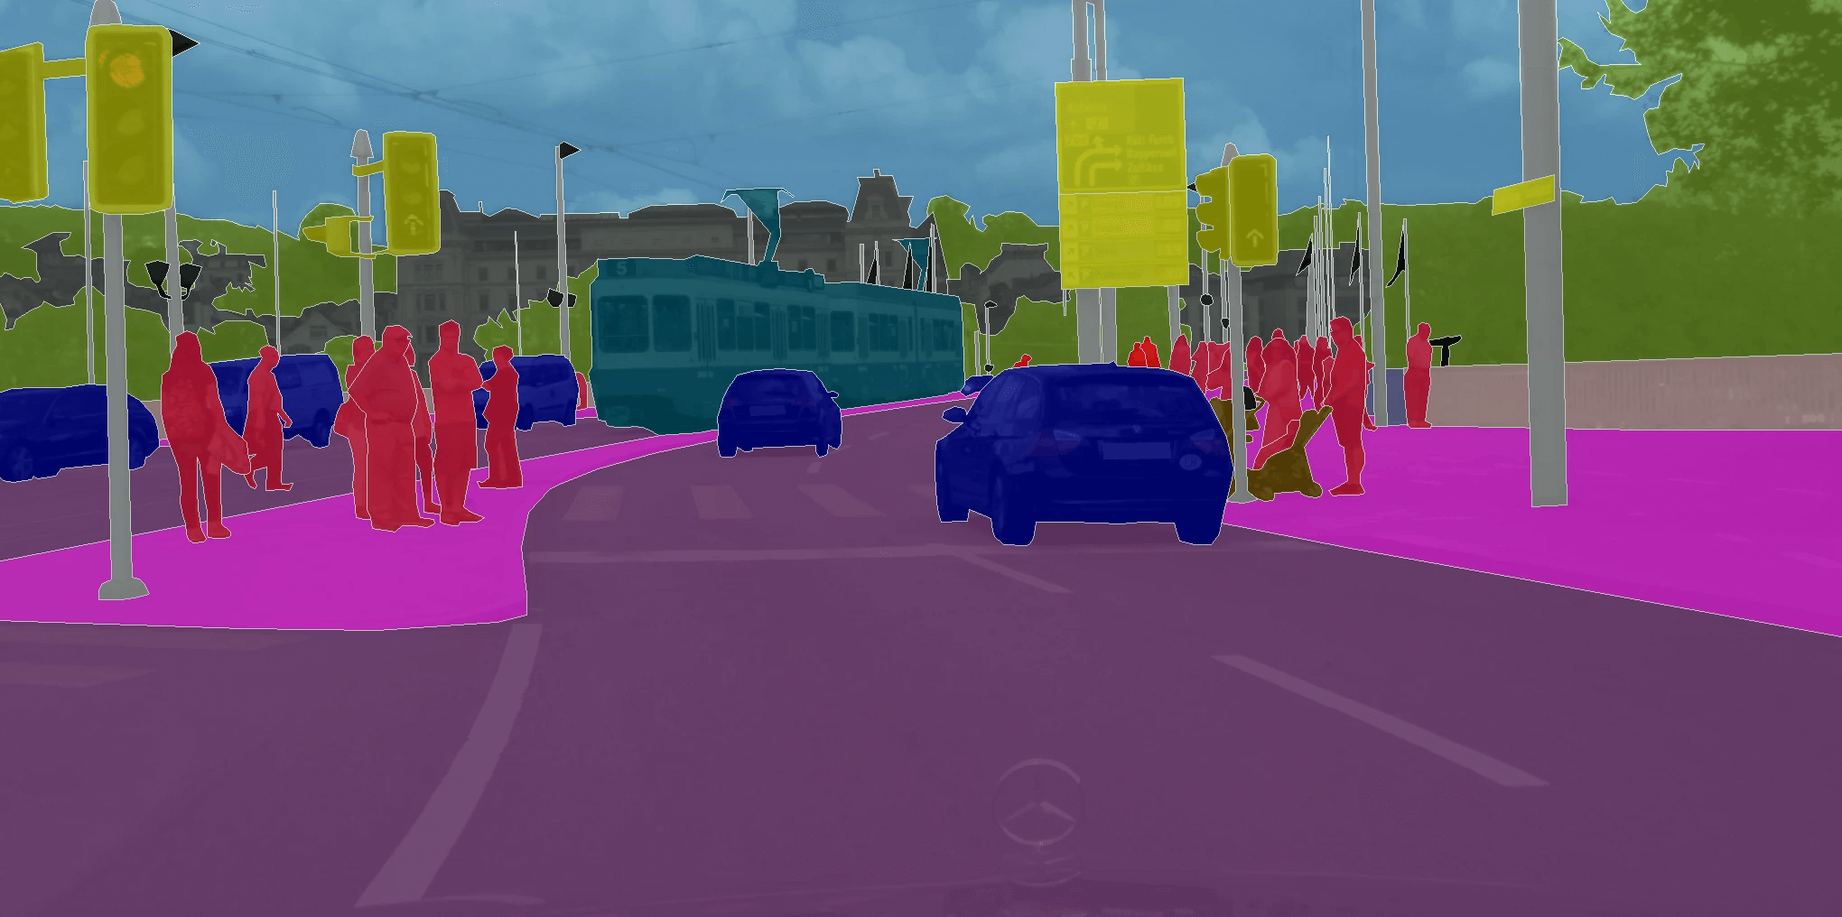
Convolutional Neural Networks
Used extensively in visual understanding tasks
Object detection Which objects are in the image, and where?
Image segmentation Which object does each image pixel represent?
Image classification What is in an image (not where)?

Slide 5
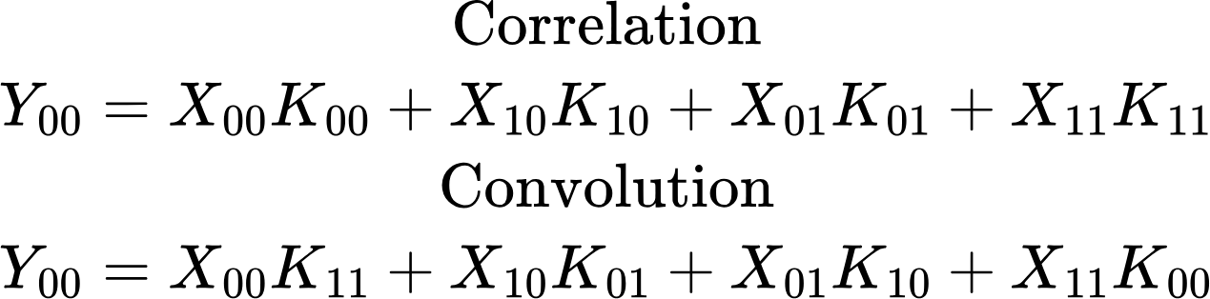
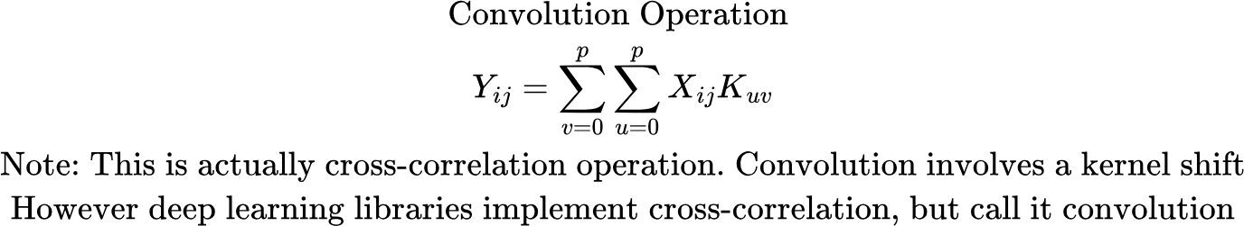
Convolutional Kernel
k00 | k01
k10 | k11
X00 | X01 | X02 | X03 | X04 | X05
X10 | X11 | X12 |  |  | X15
X20 | X21 | X22
X50 |  |  |  |  | X55
X00 | X01 | X02 | X03 | X04 | X05
X10 | X11 | X12 |  |  | X15
X20 | X21 | X22
X50 |  |  |  |  | X55
Move kernel by 1 unit (stride length = 1)
Convolutional kernel

Slide 6
Convolutional Kernel
X00 | X01 | X02 | X03 | X04 | X05
X10 | X11 | X12 |  |  | X15
X20 | X21 | X22
X50 |  |  |  |  | X55
k00 | k01
k10 | k11
Convolutional Kernel
Width/Height: Kernel Width/Height = 2 here
The same kernel is strided across the input feature map

Slide 7



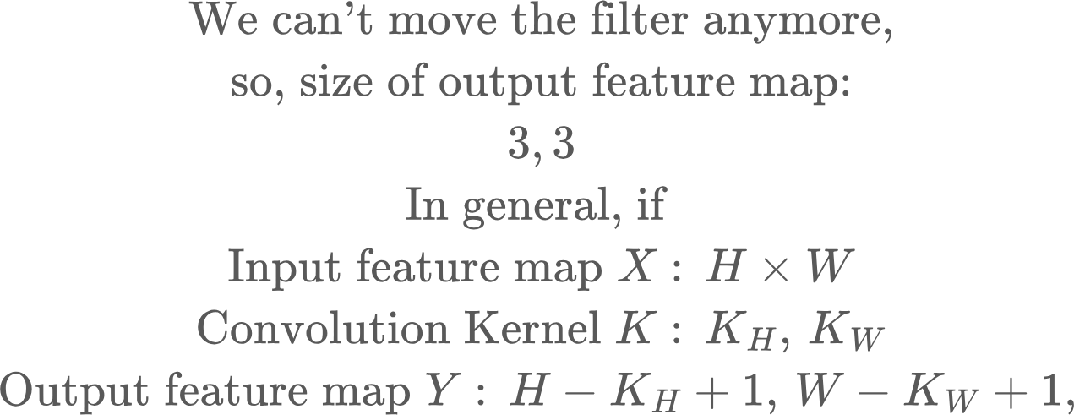
Convolutional Kernel
X00 | X01 | X02 | X03 | X04 | X05
X10 | X11 | X12 |  |  | X15
X20 | X21 | X22
X30 |  |  |  |  | X35
X00 | X01 | X02 | X03 | X04 | X05
X10 | X11 | X12 |  |  | X15
X20 | X21 | X22
X30 |  |  |  |  | X35
X00 | X01 | X02 | X03 | X04 | X05
X10 | X11 | X12 |  |  | X15
X20 | X21 | X22
X30 |  |  |  |  | X35

Slide 8
Why convolutions?
Convolutions have the right “inductive biases” for images. An inductive bias is the set up assumptions that your model bakes in about patterns in your data. These assumptions restrict the hypothesis space, so you can learn from fewer examples, smaller models and generalize better.
Inductive biases in images:
Locality: A pixel is one part of the image is unlikely to affect a pixel far away from it (unlike text). A pixel generally interacts with pixels in a small vicinity of it. Visual structure is local. Small conv kernel windows extract useful local features (edges, textures, corners) and build higher level abstractions by composing local patterns. A fully connected MLP would assume every pixel is connected with every other pixels..
Translation Invariance: A cat detector should work everywhere in the image.. Not just in a particular position. Without this bias, we’ll have to build separate detectors for the same feature at different locations in the image.. Convolutions apply this bias by using the same kernel everywhere in the image

Slide 9



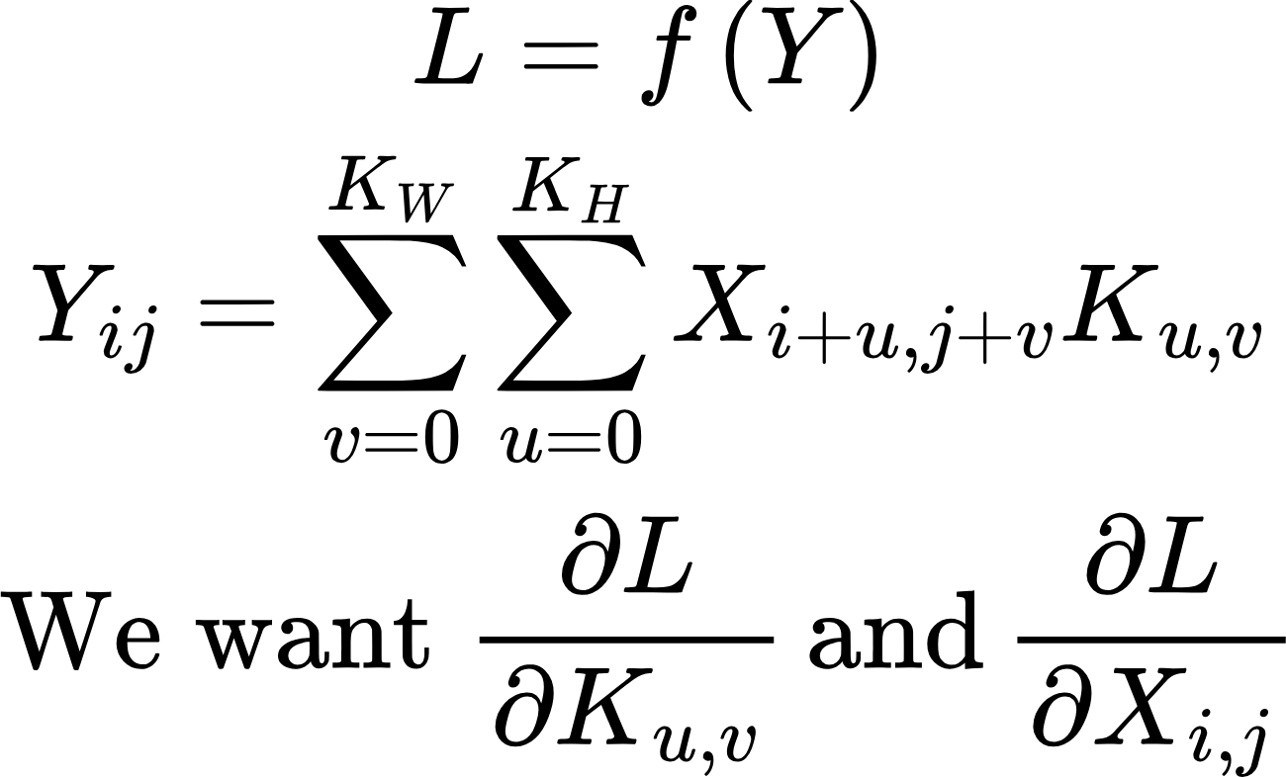
Convolution layer: Gradient
f(Y)
Layer l
Other layers + Loss function
Convolution
Eg., for i,j = 1,1, Kw, Kh = 2

Slide 10
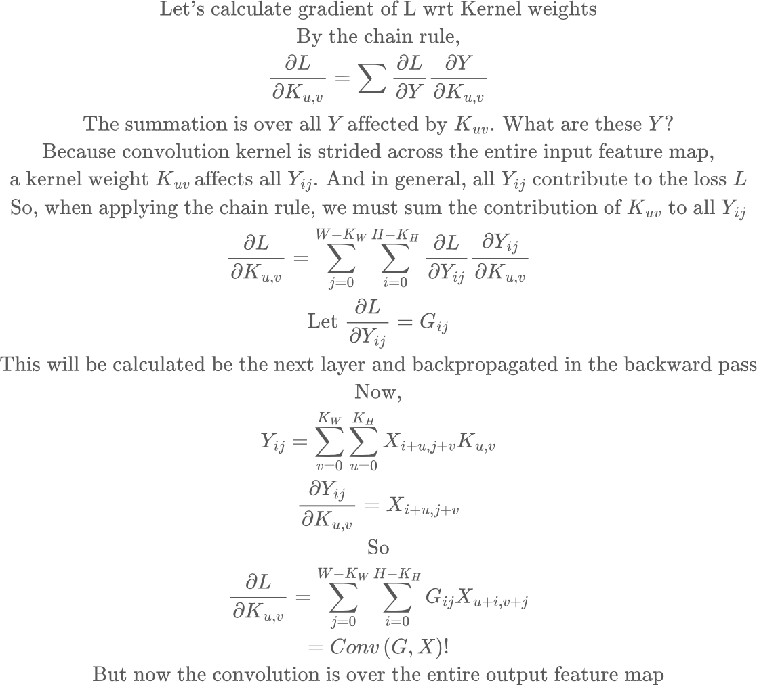
Convolution layer: Gradient
Gradient wrt kernel weights

Slide 11
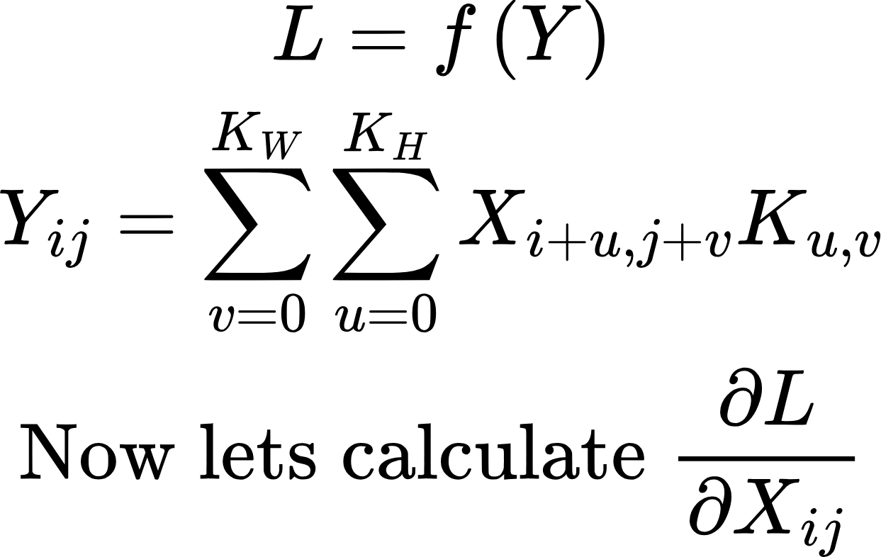
Convolution layer: Gradient
Now for gradient wrt the input
Layer l
Other layers + Loss function
Convolution

Slide 12
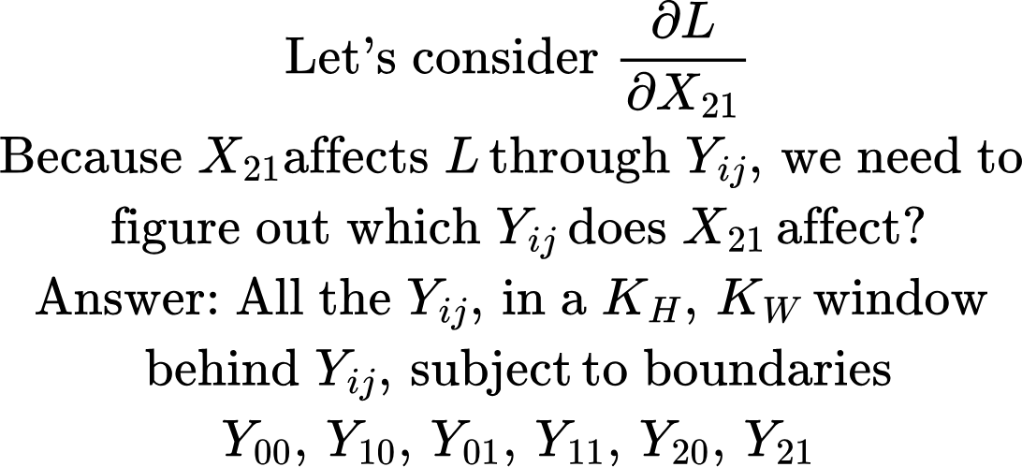
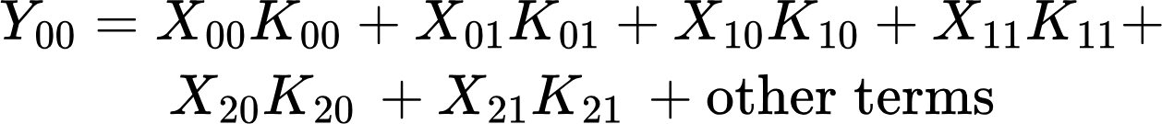
Convolution layer: Gradient
X00 | X01 | X02 | X03
X10 | X11 | X12 | X13
X20 | X21 | X22 | X23
X30 | X31 | X32 | X33
X40 | X41 | X42 | X43
X00 | X01 | X02 | X03
X10 | X11 | X12 | X13
X20 | X21 | X22 | X23
X30 | X31 | X32 | X33
X40 | X41 | X42 | X43
X00 | X01 | X02 | X03
X10 | X11 | X12 | X13
X20 | X21 | X22 | X23
X30 | X31 | X32 | X33
X40 | X41 | X42 | X43
X00 | X01 | X02 | X03
X10 | X11 | X12 | X13
X20 | X21 | X22 | X23
X30 | X31 | X32 | X33
X40 | X41 | X42 | X43

Slide 13
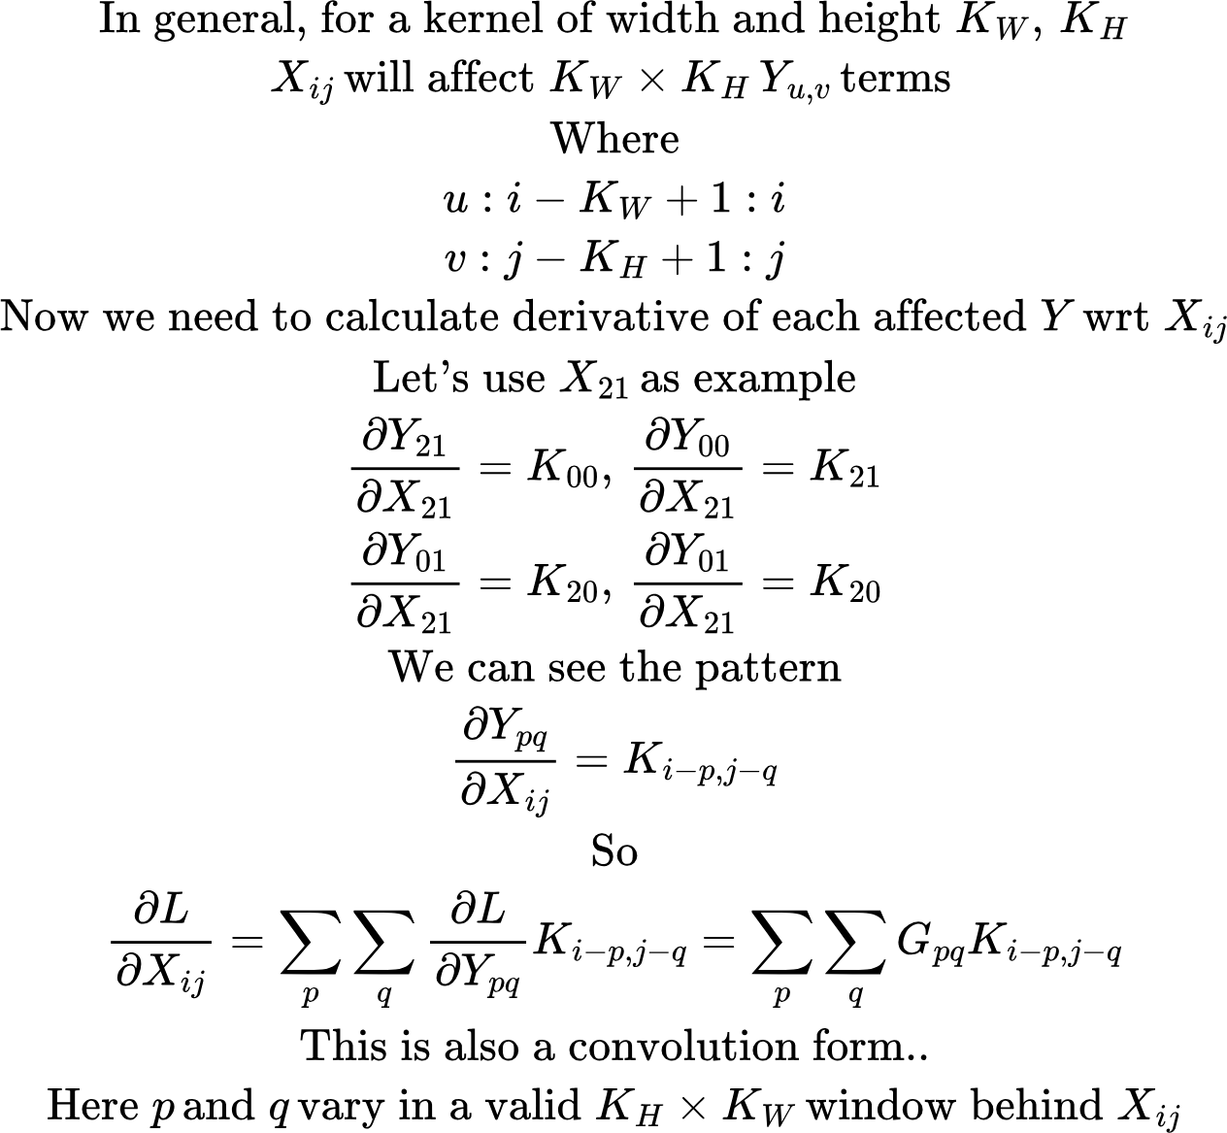
Convolution layer: Gradient

Slide 14
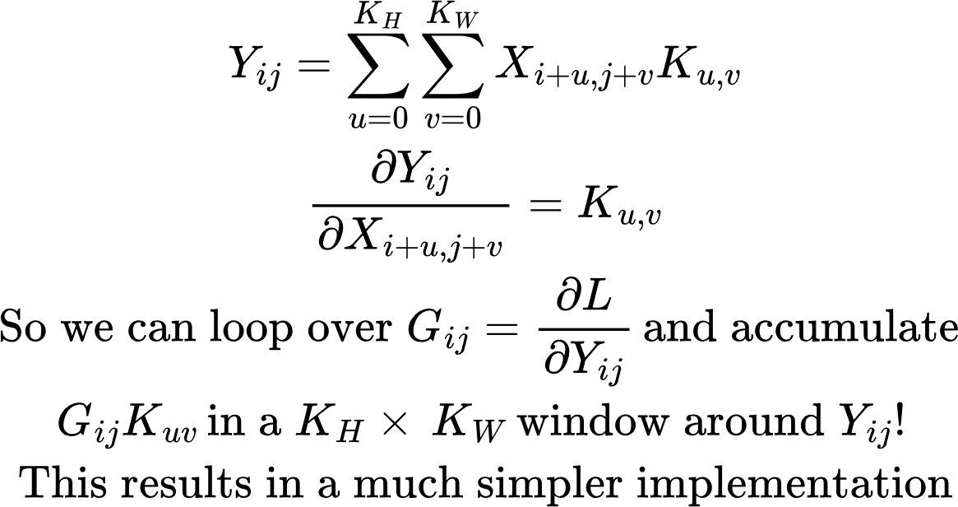
Convolution layer: Gradient
Could also ask the opposite question: Which X affect a given Y_ij, and by how much? Then accumulate the influence of that Y_ij on those X. Eg., Y21 is affected by the X in the shaded area
X00 | X01 | X02 | X03
X10 | X11 | X12 | X13
X20 | X21 | X22 | X23
X30 | X31 | X32 | X33
X40 | X41 | X42 | X43

Slide 15

Multiple Input and Output Channels
kn1
In general, we’ll have n input feature maps, and m output feature maps. We’ll have n times m convolution kernels, with each kernel a KH times KW window. There is usually also a trainable bias parameter. The output maps are calculated by convolving and accumulating the input feature map with the corresponding kernel, and adding the bias
k21
k11
cn
O1 = conv(c1,k11) + conv(c2,k21) + conv(cn,kn1)+b1
c2
c1
knm
k2m
k1m
Om = conv(c1,k1m) + conv(c2,k2m) + conv(cn,knm)+bm
cn
c2
c1

Slide 16
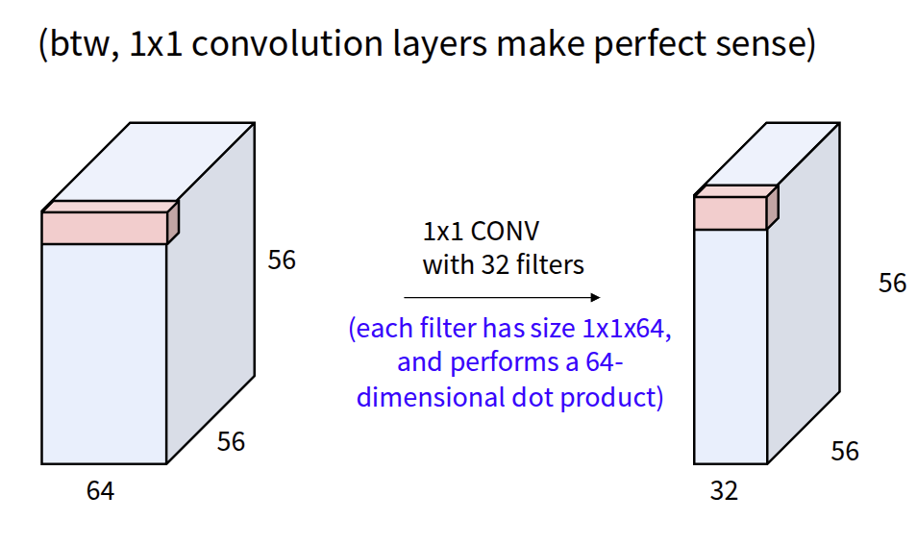
1-D convolutions
Src: https://cs231n.stanford.edu/slides/2025/lecture_5.pdf

Slide 17
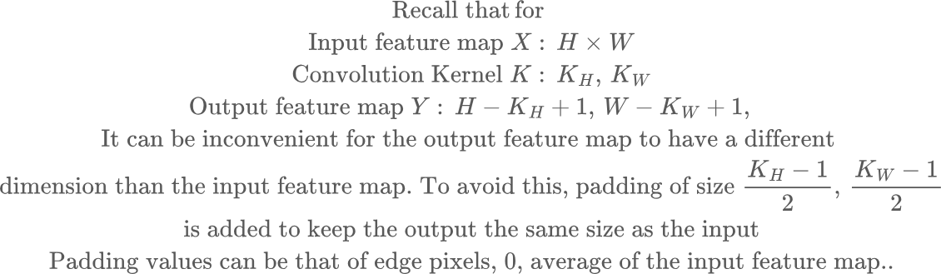
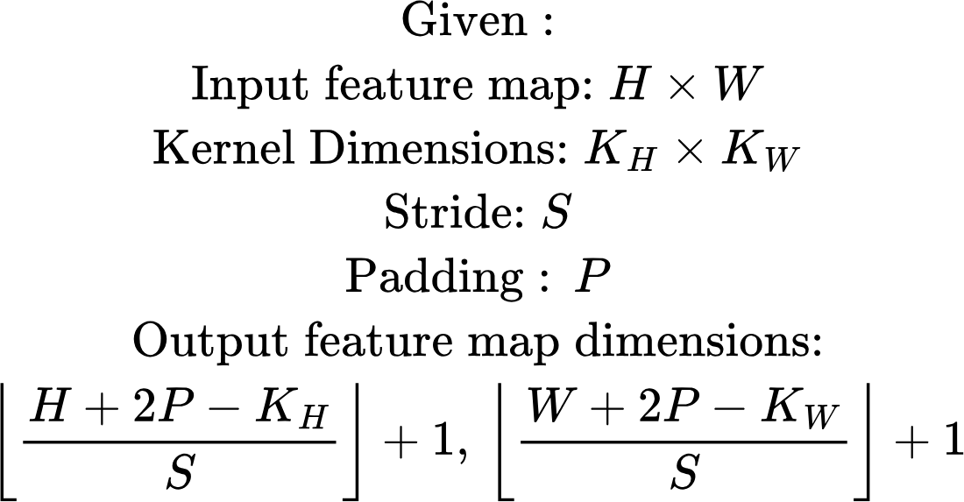
Adding Padding
 | X00 | X01 | X02
 | X10 | X11 | X12
 | X20 | X21 | X22

Slide 18
Receptive Field
Receptive Field: specific region of the input image that a neuron in a given layer "sees" or is influenced by; it starts small in early layers and grows larger in deeper layers (capturing complex shapes/objects) by aggregating information from previous layers, allowing the network to build a hierarchy of features from local details to global understanding.

Slide 19
Reducing spatial dimension
As we move forward through a network, it is common to reduce spatial dimension and add more channels. The intuition is that later layers represent more abstract concepts and need less details.
This also saves compute, which is dominated by spatial resolution. So lowering spatial resolution lets us afford more channels (richer features), keeping compute manageable
There are two main methods to reduce spatial dimension:
Pooling
Striding

Slide 20
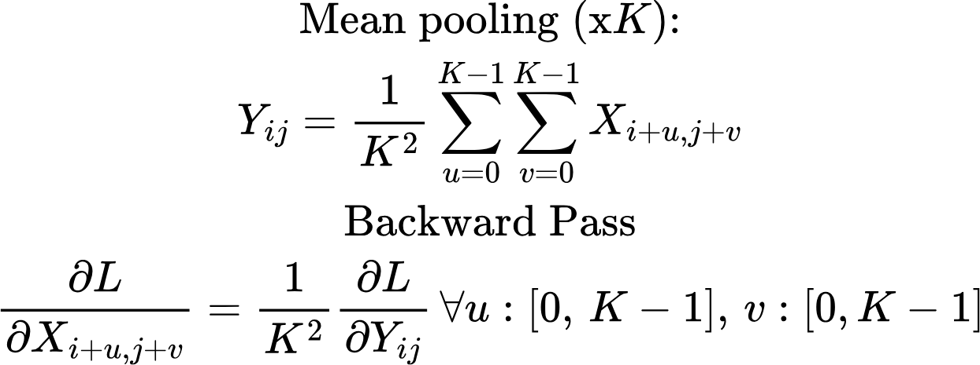
Reducing spatial dimensions: Pooling
Max pooling
(2x)
X00 | X01 | X02 | X03
X10 | X11 | X12 | X13
X20 | X21 | X22 | X23
X30 | X31 | X32 | X23
max(X00, X01, X10, X11) | max(X02, X03, X12, X13)
max(X20, X21, X30, X31) | max(X22, X23, X32, X33)
Mean pooling
Avg(X00, X01, X10, X11) | Avg(X02, X03, X12, X13)
Avg(X20, X21, X30, X31) | Avg(X22, X23, X32, X33)

Slide 21
Reducing spatial dimensions: Striding
X00 | X01 | X02 | X03
X10 | X11 | X12 | X13
X20 | X21 | X22 | X23
X30 | X31 | X32 | X23
Conv2d (X00, X01, X10, X11) | Conv2d (X02, X03, X10, X11)
Conv2d(X20, X21, X30, X31) | Convd(X22, X23, X32, X33)
Stride = 2
Y00
Y01
X00 | X01 | X02 | X03
X10 | X11 | X12 | X13
X20 | X21 | X22 | X23
X30 | X31 | X32 | X23
X00 | X01 | X02 | X03
X10 | X11 | X12 | X13
X20 | X21 | X22 | X23
X30 | X31 | X32 | X23

Slide 22
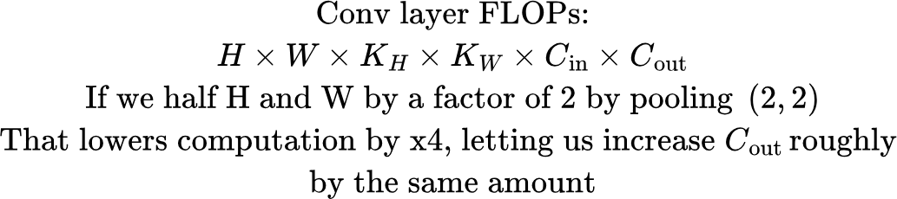
CNN Architectures: Image Classification
x5
x5
CNN (H,W,c=32)
Downsample
(H/2,W/2,c=64)
CNN (H/2,W/2,c=64)
Downsample
(H/4,W/4,c=128)
Each layer successively refines features
AvgPool
(across spatial dimension) 128*1
Pattern “downsample spatially, increase channels”:
Grow receptive field
Keep compute/memory manageable
Increase representation capacity where it matters
Early layers need to preserve where things are (edges at particular pixels), so you keep high spatial resolution
Deeper layers care more about what is present (a loop, a corner, a digit-part), and exact pixel location matters less, so you can reduce resolution and spend capacity on more channels (more feature types)
Classification head (typically MLP)

Slide 23

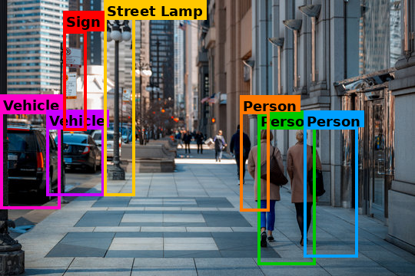
CNN Architectures: Object Detection
In object detection and classification, we need to standard the image at a high level (which objects are present) and at a low level (where specifically those objects are present). There are several methods used for this task
Conv 1d
c=32->256
C1
CNNs: H,W,c=32)
P1
CNNs: H,W,c=256)
Bounding box and classification head
Upsample
C2
CNNs: H/2,W/2,c=64)
Conv 1d
c=64->256
P2
CNNs: H/2,W/2,c=256)
Propagate up high level semantics and combine with low level details
Upsample, eg., using bilinear interpolation
C3
(CNNs: H/4,W/4,c=128)
P3
High level semantics

